Slide 1
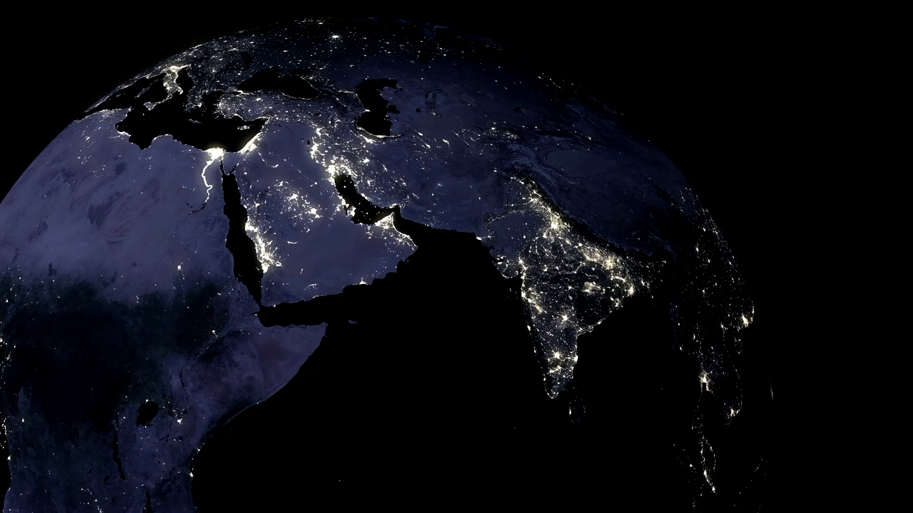
R-Ladies Jozi Meetup
How to Make Web-Ready Maps
A Beginner’s Perspective
07/02/2021
Asmae Toumi

Slide 2

How it all started…

Slide 3

?tmap
?raster
?sf
What is a shapefile?
?Leaflet
?Tableau
?plotly
What are polygons?
?who is mapbox
?D3
MULTIpolygons???

Slide 4
Considerations
Fast
Interactive
Doesn’t involve learning a new language
0$ but looks expensive

Slide 5
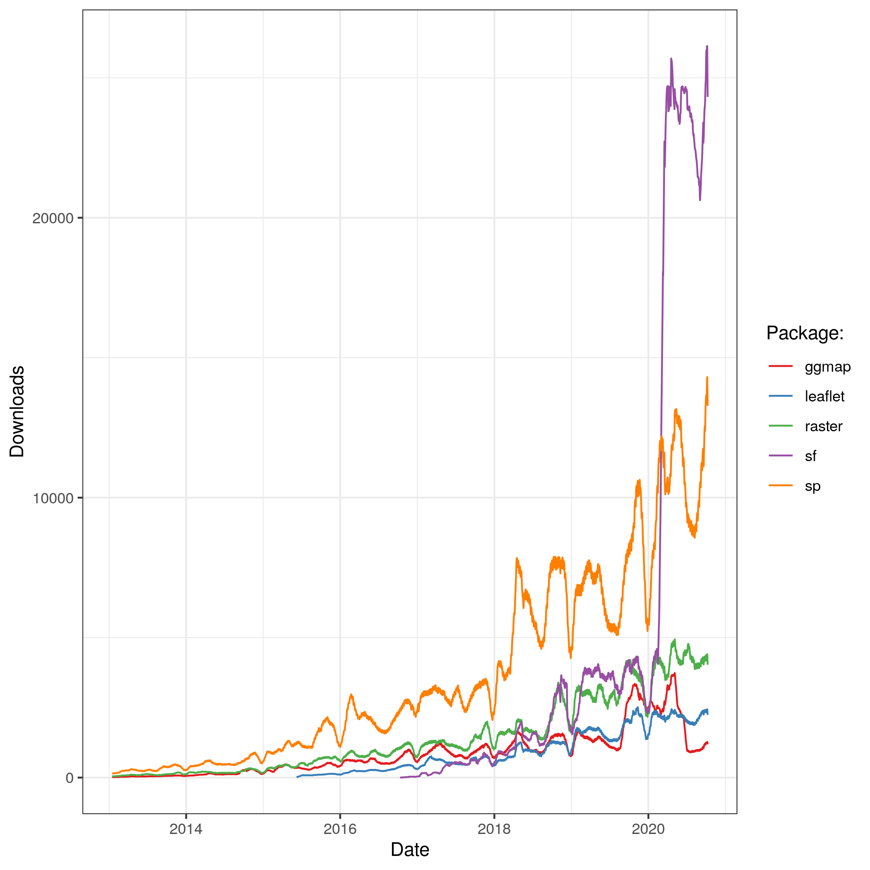
R
R’s has flexible capabilities to interface with Geographic Information System (GIS) software, ‘geolibraries’, and functions (Lovelace, 2021)
The (evergrowing) R spatial ecosystem allows for static and interactive map making
sf package: Simple Features, an open-source standard and model to store and access vector geometries, developed by the Open Geospatial Consortium
Lovelace, 2021

Slide 6
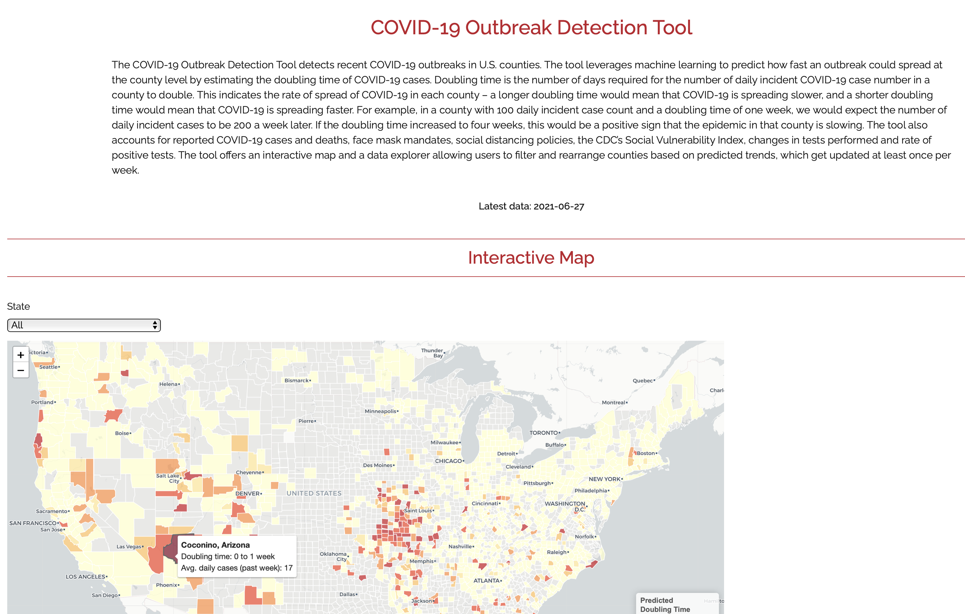
A few weeks later…
https://analytics-modeling.shinyapps.io/outbreakdetection_03/

